Slide 1


Netflix OTT Content Analysis
Minor Project Presentation
Submitted By : Sonali Tripathi,
Ujjawal Pandey,
Raj Patel
Branch: CSBS

Slide 2



Introduction to OTT: The Future of Entertainment
Over-The-Top (OTT) refers to content providers that distribute streaming media directly to viewers over the internet, bypassing traditional broadcast or cable television. This direct delivery model is revolutionising how we consume media.
Direct Delivery
Global Reach
Rapid Growth
Content delivered straight to your device.
Accessible anytime, anywhere with internet.
Increasing viewer base and content libraries.

Slide 3

Why Netflix? A Deep Dive into the Streaming Giant
We chose Netflix for our analysis due to its unparalleled global presence and its role as a pioneer in the OTT landscape. Analysing its content strategy provides invaluable insights into consumer preferences and industry trends.
Market Leader: Dominant player in the global
streaming market.
Content Diversity: Vast library with original
productions and licensed titles.
Global Impact: Influences content creation
and consumption worldwide.
Data-Rich Platform: Ideal for understanding
viewing patterns.

Slide 4
Project Objectives: Unlocking Netflix's Content Strategy
Our project aimed to dissect Netflix's content, focusing on several key areas to understand its
offerings and strategic direction.
01
02
03
Content Diversity Analysis
Genre Popularity Identification
Ratings Distribution Insight
Evaluate the range of genres and formats.
Determine the most prevalent and watched genres.
Understand content suitability across audiences.
04
05
Country Contribution Assessment
Year-Wise Content Trend
Identify key content-producing regions.
Analyse historical content addition patterns.

Slide 5
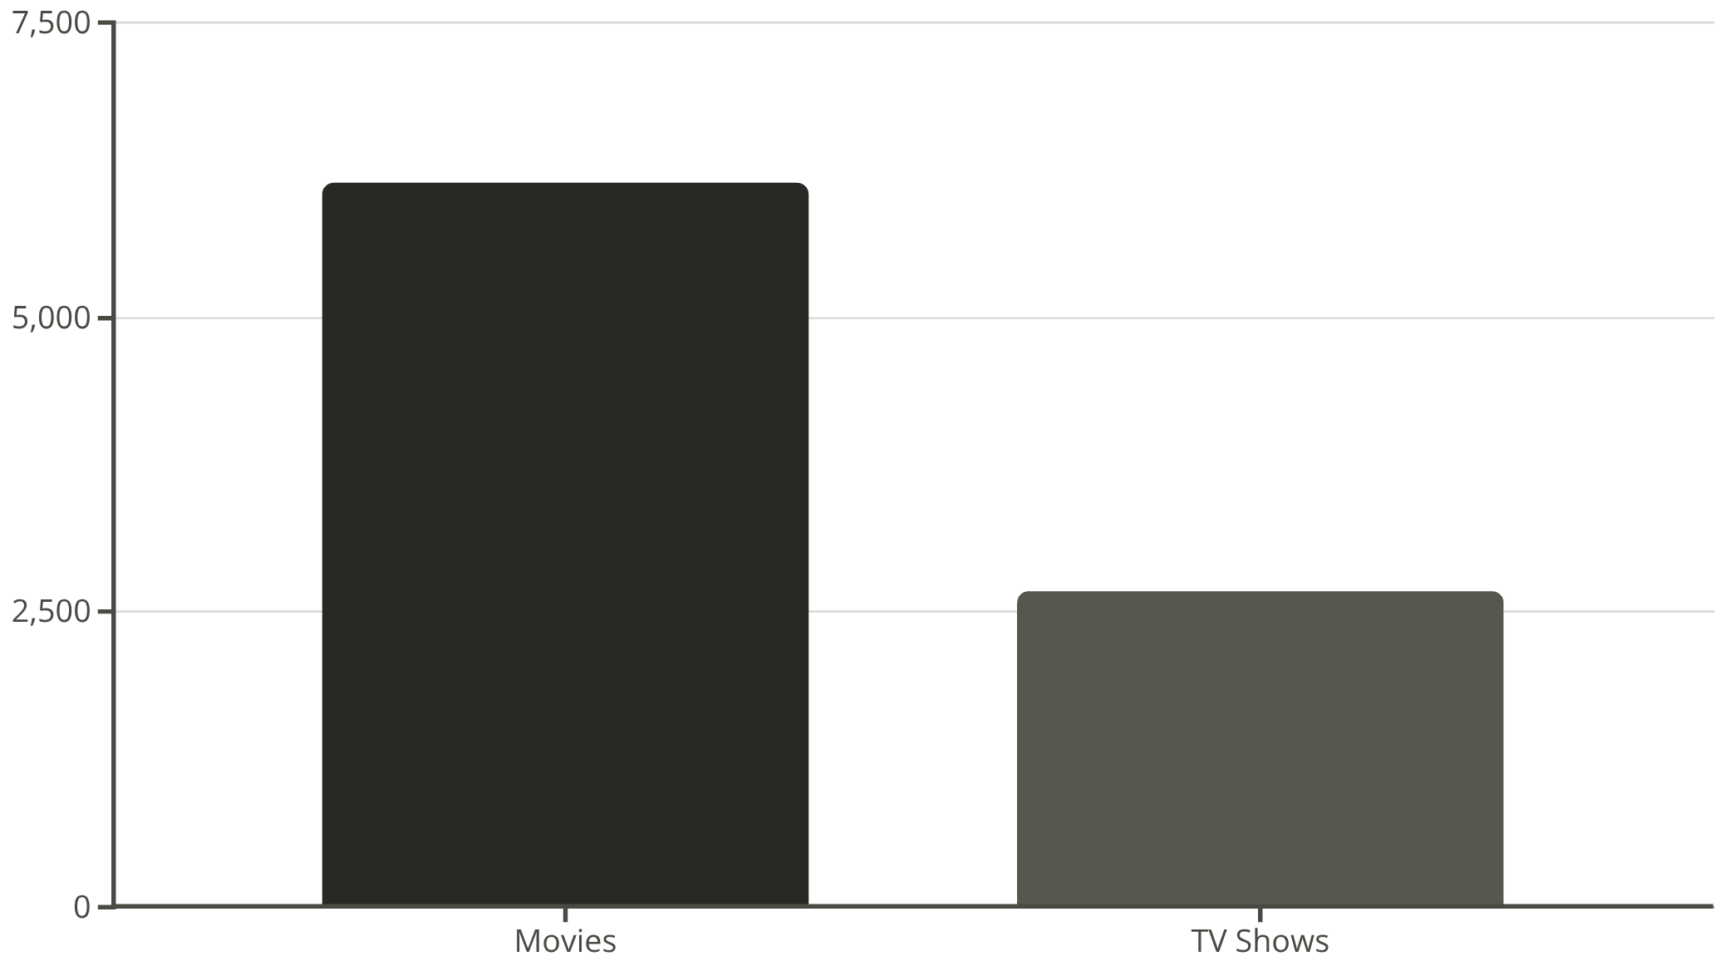

Dataset Overview: A Glimpse into Netflix's Library
Our analysis was based on a comprehensive dataset of Netflix titles, revealing a significant imbalance between movies and
TV shows.
“A small sample dataset of Netflix titles was used to demonstrate Excel-based analysis. The dataset includes movies and TV shows with attributes such as genre, country, rating, and release year.”

Slide 6

Genre Analysis: What's Popular on Netflix?
Understanding genre distribution is crucial for content strategy. Our analysis highlights the dominance
of specific genres on Netflix.
“In the sample dataset, Action is the most frequent
genre, followed by Crime, Drama, and Sci-Fi.”
This data helps Netflix curate content that resonates with its broad audience base.

Slide 7
Country Contribution: Global Content Hubs
“Most titles in the sample come from the United States, followed by India and Spain.”.
The United States leads in content production, followed by India and the UK, showcasing Netflix's investment in diverse regional content.

Slide 8
Year-Wise Trend: Netflix's Content Surge
“The sample spans titles released between 2010 and 2022, showing a variety of release years.”.
There was a significant spike in content additions between 2018 and 2020, reflecting Netflix's aggressive expansion strategy during that period.

Slide 9
Excel Dashboard : Final Summary
Netflix Content Analysis Dashboard:

Slide 10



Conclusion & Recommendations
Our analysis reveals Netflix's strategic focus on diverse content, particularly movies and mature-rated shows, with significant contributions from key countries.
Increase Global Content
Maintain Genre Variety
Expand partnerships with international creators.
Continue investing in diverse genres to cater to all tastes.
More Family-Friendly Content
Address the gap in content suitable for younger audiences.

Slide 11

Thank you !

